Slide 2
Working with Azure Database Services Platform
Roberto Freato

Slide 3
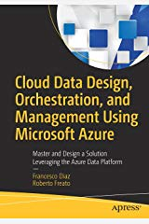
Chapter 1
Cloud Data Design, Orchestration and Management Using Microsoft Azure

Slide 4
Platform-as-a-Service
PROS:
No VMs to maintain
No separate licence to manage
No need to implement HA/HR
CONS:
«Limited» size (up to 4TB or 100TB on Hyperscale)
«Limited» performance levels (from 0 to 80 cores)
No low-level tuning (missing interface with the underlying OS)
Costs

Slide 5
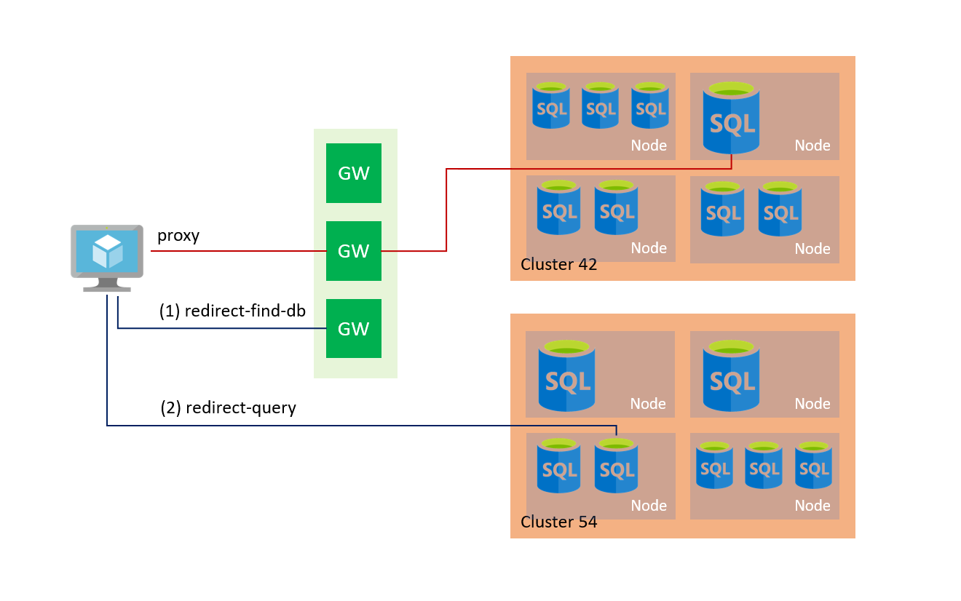
Connectivity
Public endpoint
Virtual Network (and/or specific endpoints)
PROXY MODEL

Slide 6
Tiers and models
Single database:
DTU-based
vCore-based
Serverless
Multiple databases:
Elastic Pools (DTU or vCore based)
Managed Instances

Slide 7
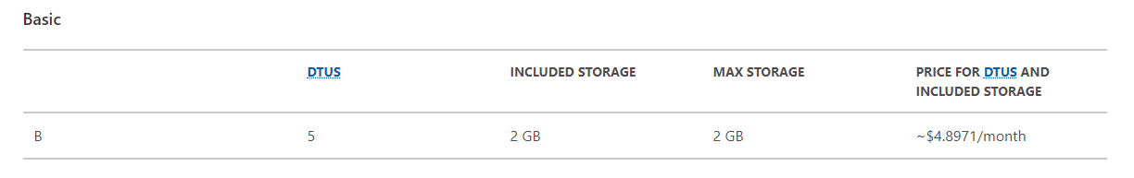
Single: DTU-based (Basic)

Slide 8
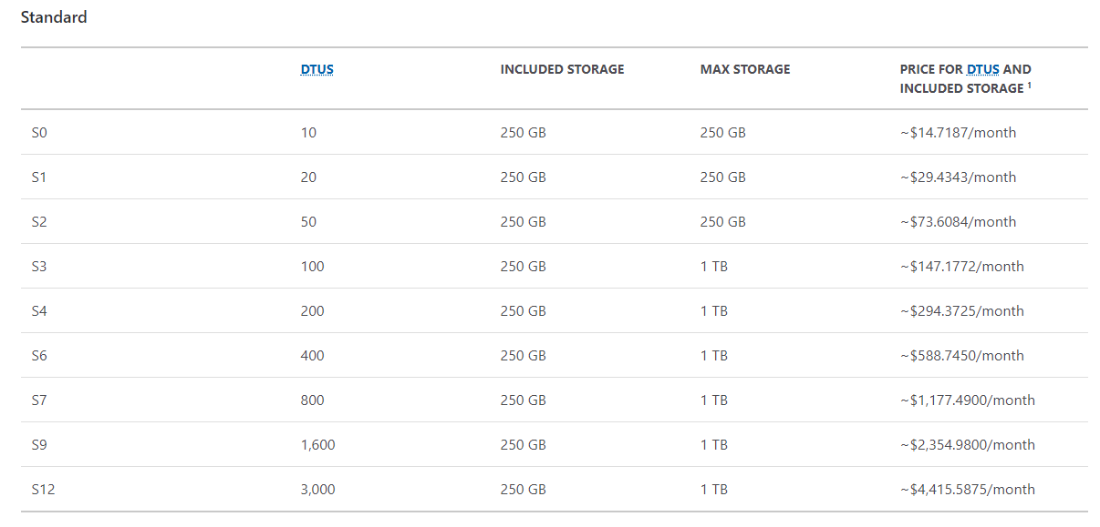
Single: DTU-based (Standard)

Slide 9
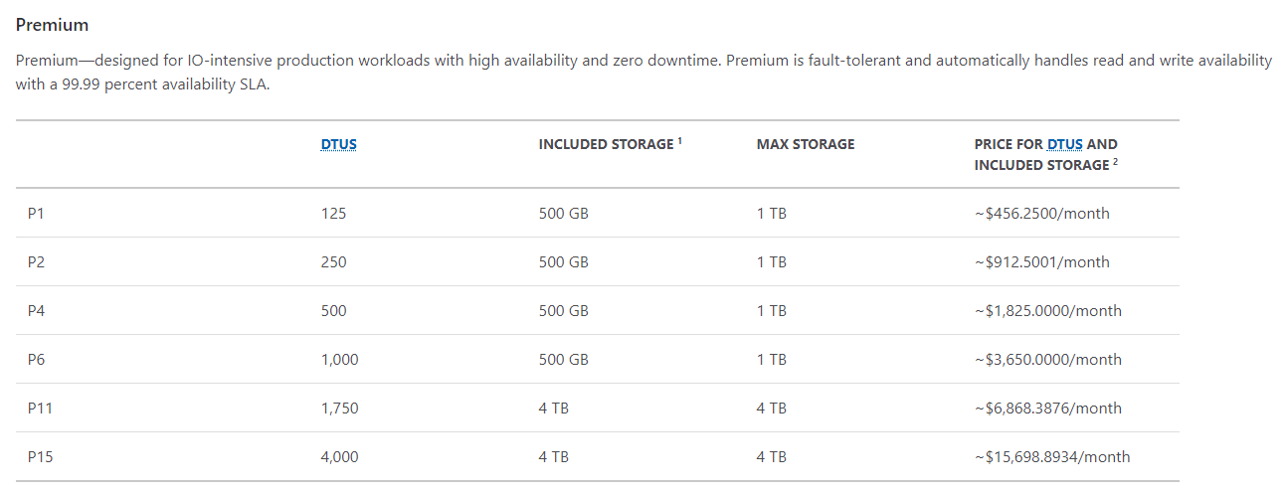
Single: DTU-based (Premium)

Slide 10
Single: vCore-based
General purpose: some caps in performance
Business critical: much performance
Hyperscale: different architecture (up to 100TB)
PLUS
Hybrid Benefit
Serverless

Slide 11
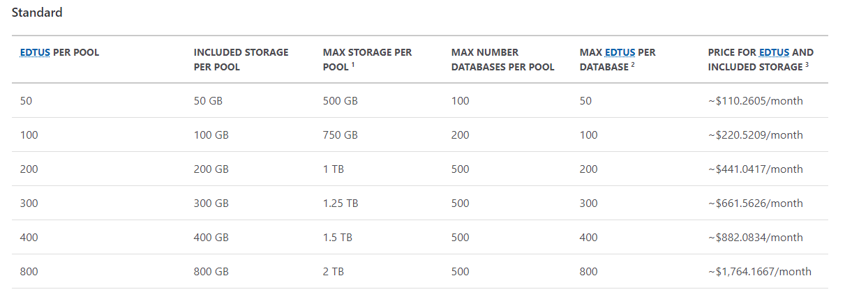
Multiple: elastic pools
vCore model has same price point

Slide 12
DEMO
Tiers

Slide 13
Security Basics
Server-level:
Virtual Network
Encryption (TDE + TLS)
Both Server-level and Database-level
Firewall
Authentication
Always Encrypted
Dynamic Data Masking

Slide 14
DEMO
Firewall, Always Encrypted, Authentication, Data Masking

Slide 15
Automatic tuning

Slide 16
Read replica
Always available in:
DTU-based Premium Tier
vCore-based Business Critical
vCore-based Hyperscale
ApplicationIntent = ReadOnly

Slide 17
DEMO
Read replicas

Slide 18
Geo-replication

Slide 19
Failover groups
Define a primary DNS endpoint
Bound the (current) primary DB to the endpoint
To the same with a secondary endpoint
Transparent usage of the primary endpoint from applications

Slide 20
DEMO
Geo-replication and Failover groups

Slide 21
Backups
Point-In-Time restore (up to 35 days)
Long-term backups
Copies

Slide 22
DEMO
Backups and copies

Slide 23
Security basics (2)
Query Performance Insight
Database Auditing
Advanced Data Security

Slide 24
DEMO
Query store & Auditing

Slide 25
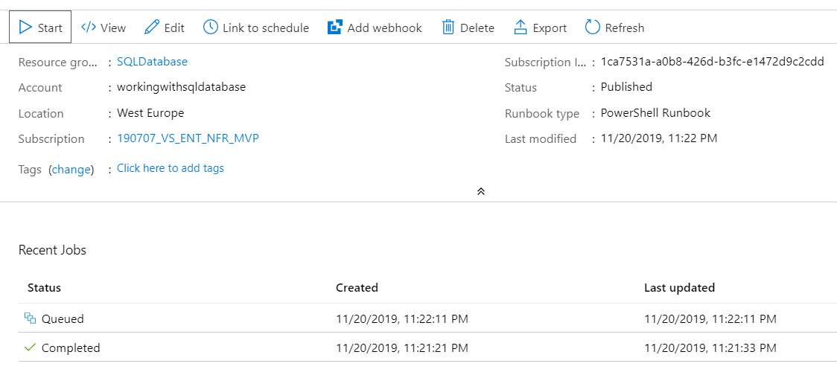
Automation
Use Automation (Powershell-as-a-Service)
Organize tools in Runbooks
Centralize variables and secrets
Capture logs

Slide 26
DEMO
Automation

Slide 27
Takeaways
Reduced effort in governance
Many deployment and consolidation options
Several pricing tiers
Many of the SQL Server features (preview ones!)
Intelligent features (like auto-tuning)
Designed for HA/HR (geo-replication, failover groups)
No backup hassle

Slide 28

Q&A

Slide 29







Contatti
OverNet Education
Info@OverNetEducation.it
www.OverNetEducation.it
Rozzano (MI) +39 02 365738
Bologna +39 051 269911
www.wpc-overneteducation.it
#wpc19it

